Slide 1
ROLE OF TEACHERS IN IDENTIFYING LEARNING DISABILITIES
Dr. P.R. Sisir M.D.(Hom.)
Prof. & Head, Dept. of Paeditrics,
Sarada Krishna Homeopathic Medical College

Slide 2
Classification
Specific development disorders | Mental retardation
 | Disorders of speech & language : Developmental articulation disorder. Stuttering Expressive language disorder. Receptive language disorder.
 | Disorders of scholastic skills: Reading disorders Writing disorders Mathematics disorders Motor skill disorders.
Pervasive developmental disorders | Autistic disorder. Rett’s syndrome. Asperger’s Syndrome.
Externalizing disorders | Conduct disorders Oppositional defiant disorder
Internalizing disorders | Separation anxiety disorders Phobic anxiety disorders Social anxiety disorders Depressive disorders.
Hyperkinetic disorders | Attention –deficit hyperactivity disorder
Miscellaneous | Tourette ‘s disorders Nocturnal enuresis Encopresis

Slide 3
Disorders of speech & language :
Developmental articulation disorder.
Stuttering.
Expressive language disorder.
Receptive language disorder.

Slide 4
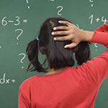
Receptive language disorder:
Reading disorders
Writing disorders
Mathematics disorders
Motor skill disorders.

Slide 5
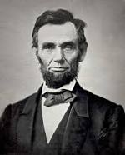
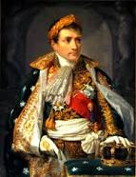
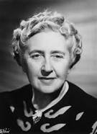
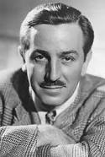
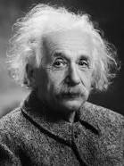
Famous People with Learning Disabilities
Alexander Graham Bell – Bell invented the telephone, but struggled with traditional schooling. It’s believed that he had some form of learning disability, possibly dyslexia.
Napoleon Bonaparte – Napoleon’s hypersensitivity to touch and his military strategic genius are two of the many symptoms that have led some modern scholars to suggest that he was a high-functioning autistic.
Agatha Christie – Christie was the most famous mystery novelist of her time and developed a rich writing style that has impacted almost every mystery writer of the 20th and 21st centuries. Christie had dysgraphia, a learning disability that affected her ability to understand written words.
Walt Disney – While no hard evidence exists, many scholars believe that Disney suffered from dyslexia or a related disorder due to his difficulties in school. Disney eventually dropped out of high school and pursued a career as an artist.
Albert Einstein – Einstein’s parents once thought that he was mentally retarded due to his odd habits and difficulties in school. If he were born today, Einstein would probably be diagnosed with Asperger’s Syndrome, a mild form of autism.

Slide 6
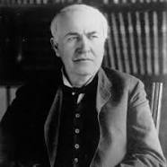
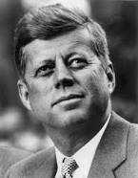
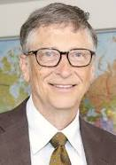
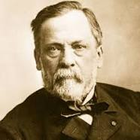
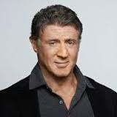
Famous People with Learning Disabilities
Thomas Edison – Edison is believed to have had dyslexia and possibly ADHD.
His mother took him out of school at an early age, and Edison was home-schooled.
He developed a voracious appetite for reading and made major scientific breakthroughs with his unusual methodology.
John F. Kennedy – President Kennedy may have had a form of dyslexia, but it didn’t keep him from pursuing a successful education. He graduated from Harvard and won the presidency of the United States in 1961.
Bill Gates – Some autism experts have suggested that the head of Microsoft has Asperger’s.
Louis Pasteur – Pasteur’s scientific work saved countless lives through his discovery of the now-common technique of pasteurization. Pasteur’s learning difficulties in certain fields indicate a possible disability.
Sylvester Stallone – Stallone is one of the highest paid actors of all time. He suffers from dyslexia, but has developed an outstanding talent for screenwriting. His writing credits include “Rocky” and “Over the Top”, both of which he starred in.

Slide 7
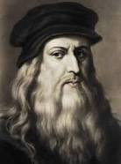
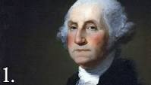
Famous People with Learning Disabilities
Leonardo da Vinci – Da Vinci was a perfectionist who may have had Asperger’s, as he had savant-like skills and an enormous single-minded dedication to art and science.
George Washington – Despite his education, Washington was unable to spell properly and may have had a severe learning disorder. It’s likely that he was dyslexic. He’s probably the best known founding father of the United States and the first U.S. President.

Slide 8
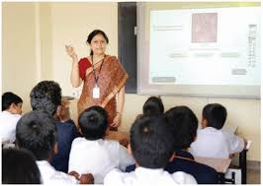
WHAT A TEACHER CAN DO?

Slide 9
THANK U ALL…

